Slide 1
New learners, new challenges,
and new opportunities:
Accessibility and Universal Design in post-pandemic higher education classrooms
Kem Saichaie, PhD
Inaugural Executive Director
UCLA Teaching and Learning Center
ksaichaie@teaching.ucla.edu
May 14, 2026

Slide 2
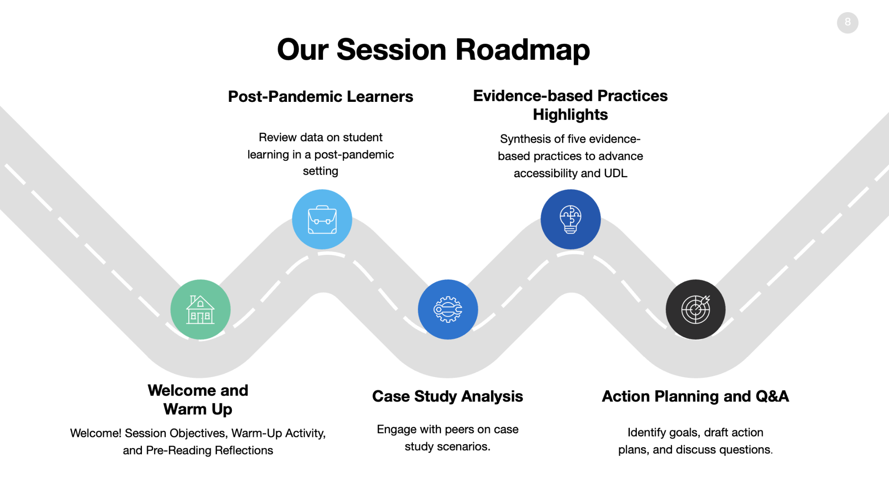

Slide 3
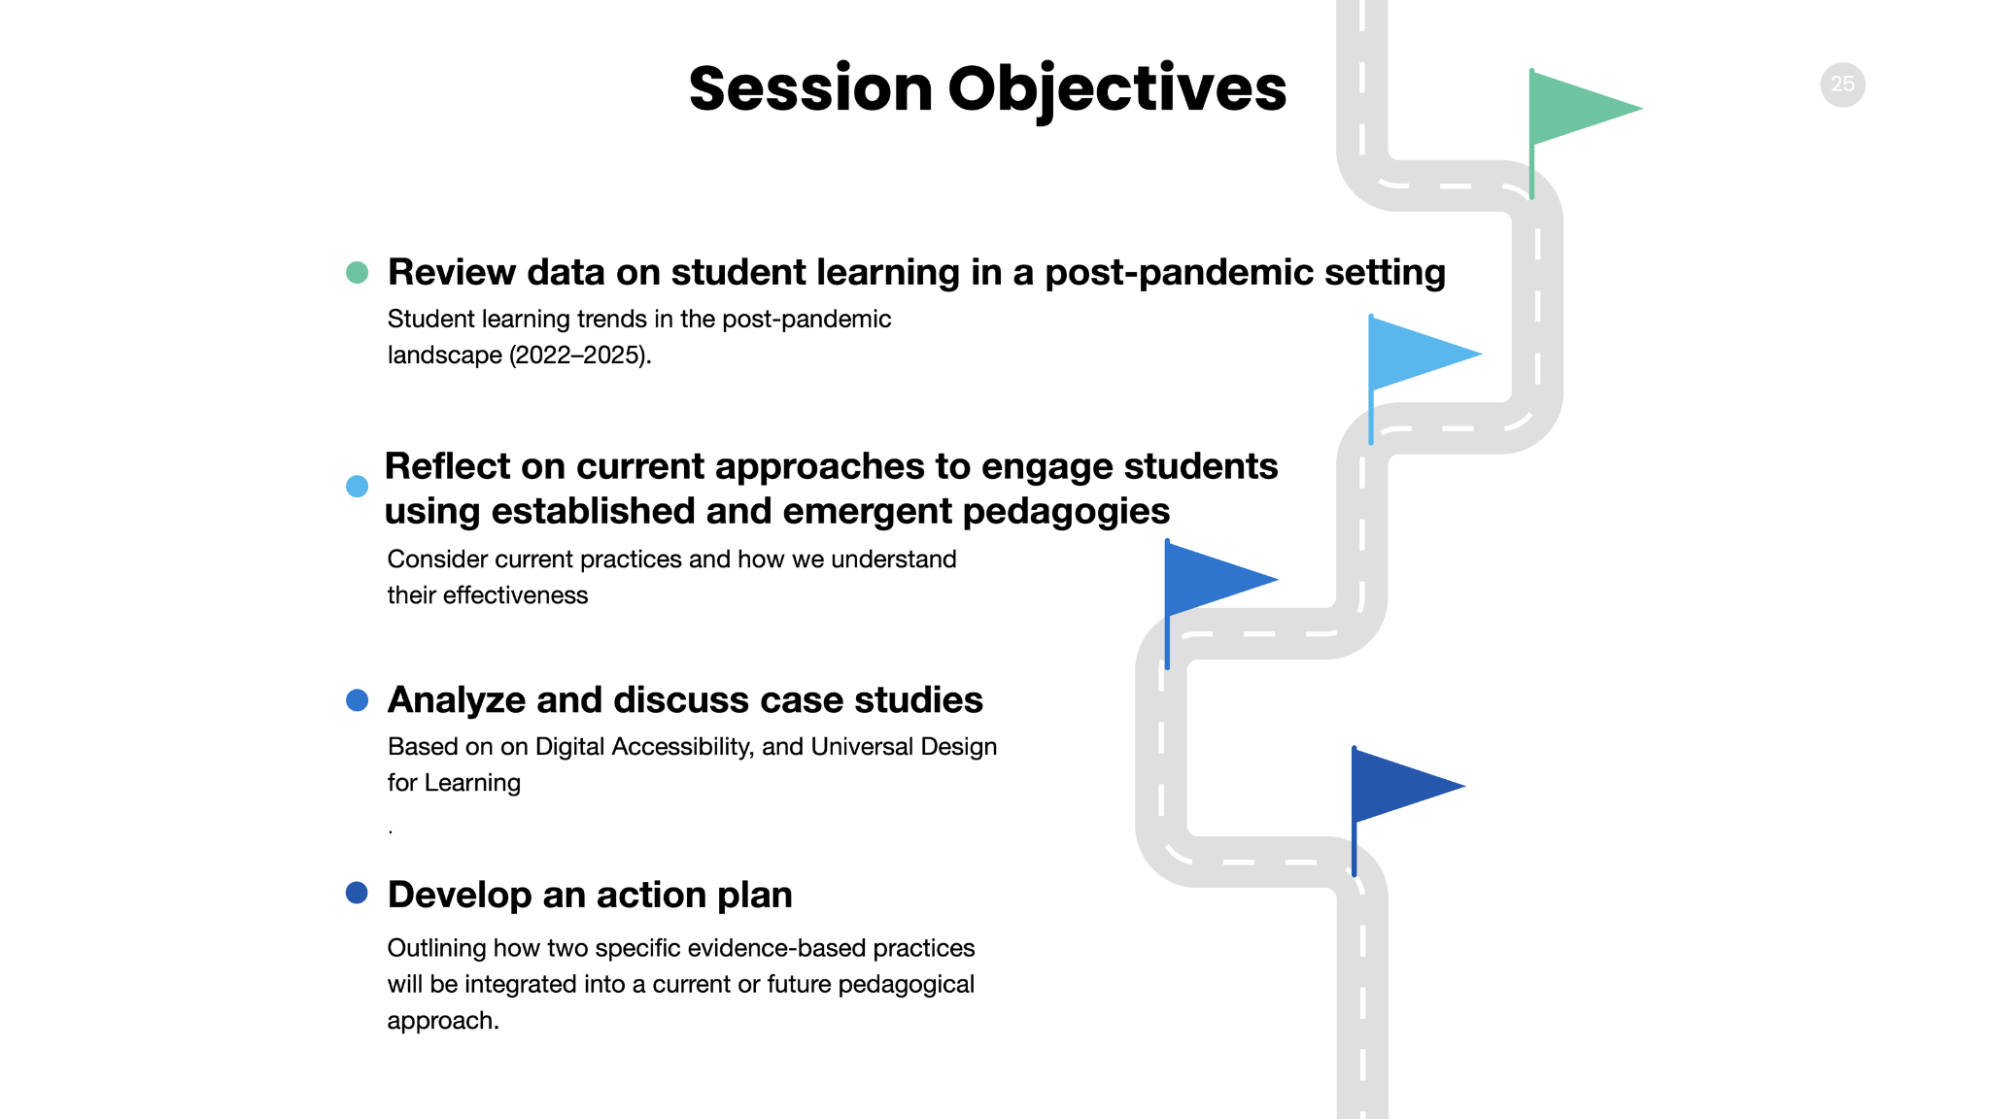

Slide 4






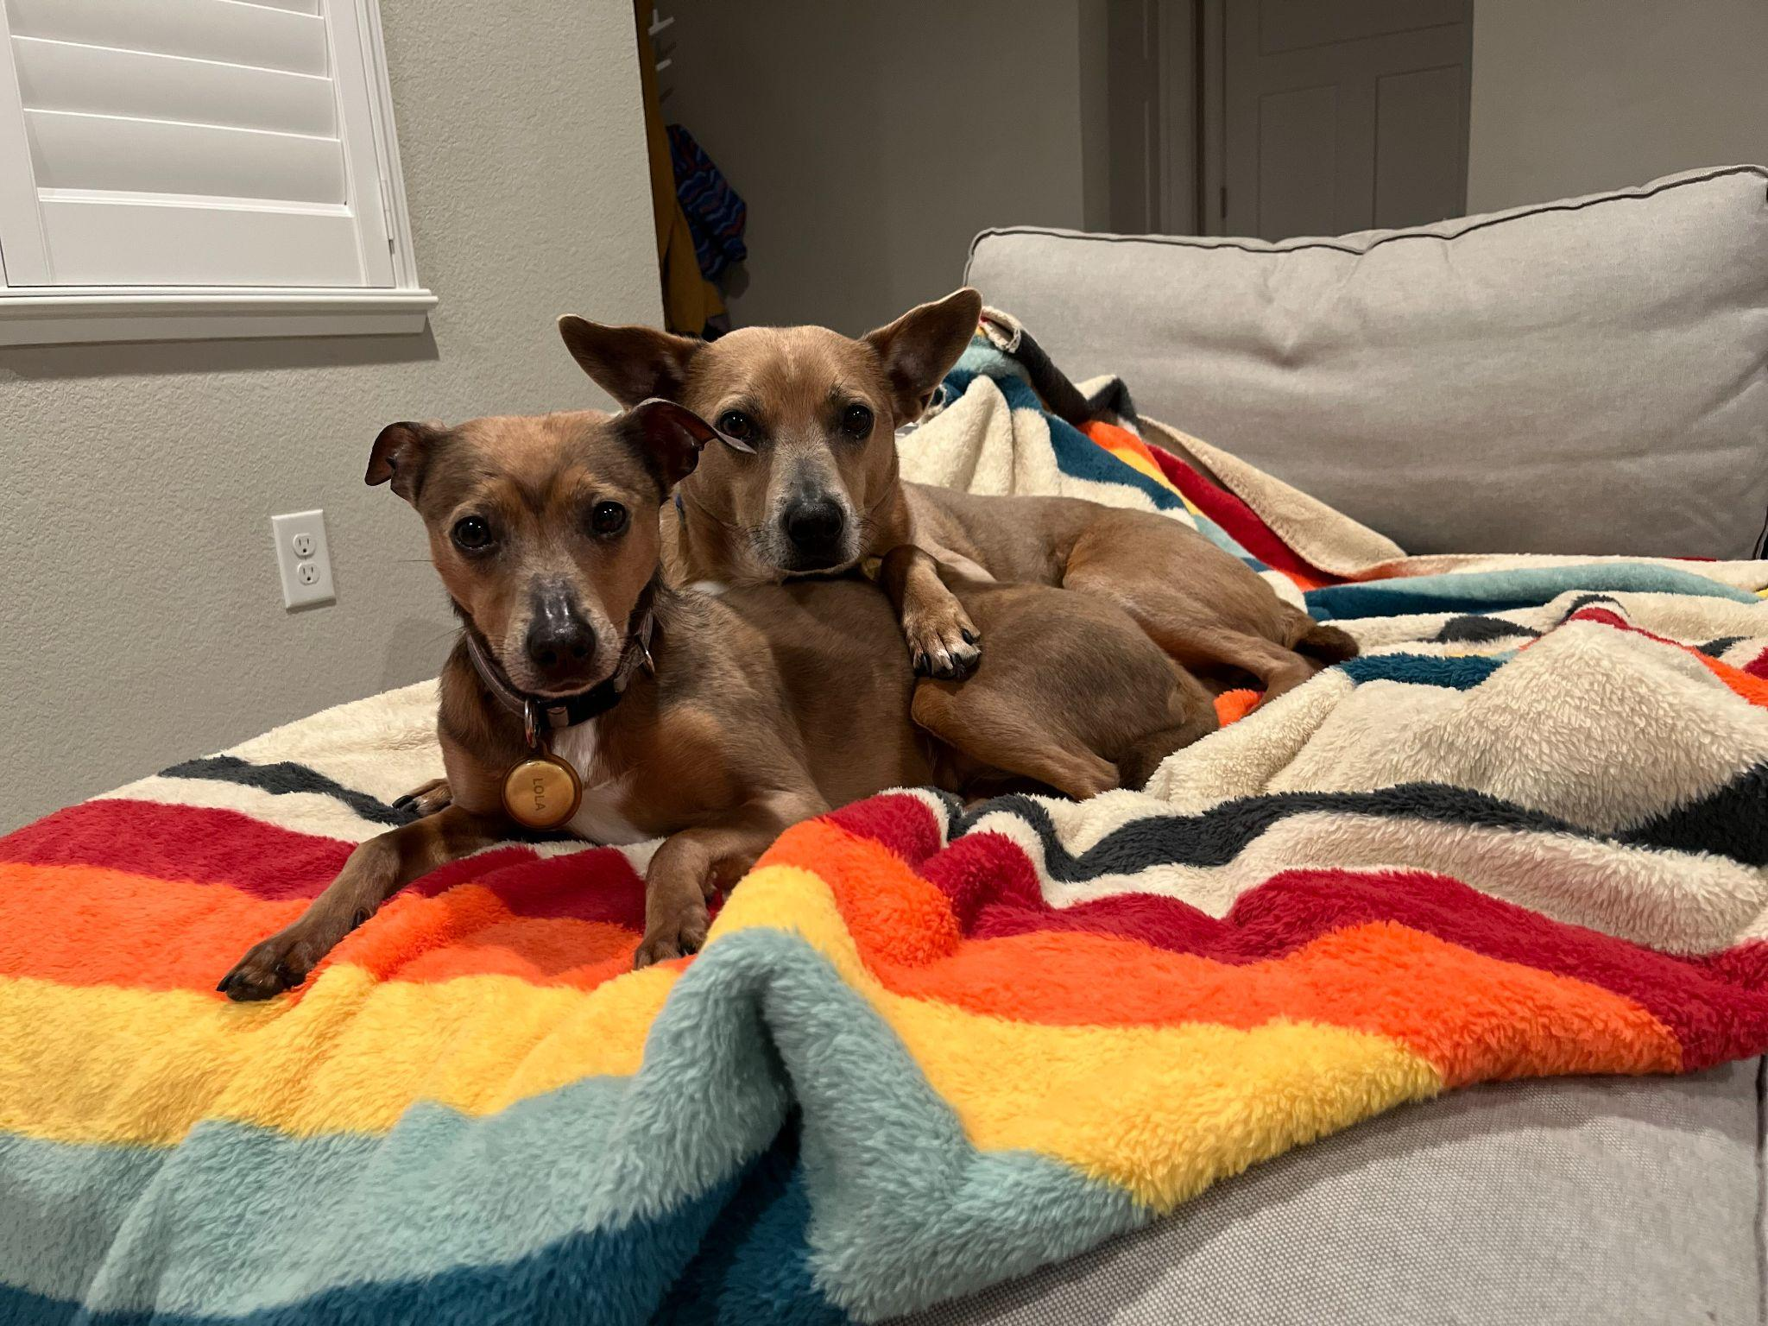
Kem Saichaie (he/him)
Chem Sigh-Chai
Inaugural Executive Director UCLA Teaching and Learning Center | Inaugural Executive Director Center for Educational Effectiveness Educational Specialist Center for Excellence in Teaching & Learning Lecturer School of Education | Director of Educational Technology Center for Teaching and Faculty Development Adjunct Faculty Department of Educational Policy, Research, and Administration | Academic Technology Consultant & Researcher Office of Information Technology Affiliate Faculty Department of Organizational Leadership, Policy, and Development | Faculty Development Consultant Instructional Technology Services Teaching Assistant College of Education Multimedia Producer Office of Admissions | Assistant Professor of Communication Department of Communication and Theatre Arts Director of Mass Media Faculty advisor and founder of online radio, television, and newspaper student media outlets

Slide 5
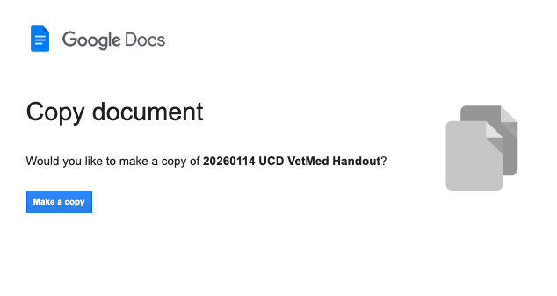
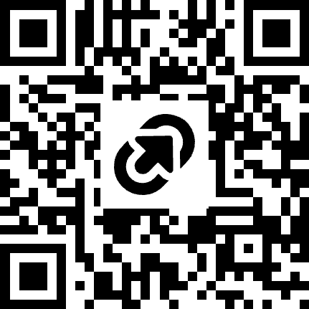
Access Session Handout
https://tinyurl.com/UCD-1-14-2026

Slide 6
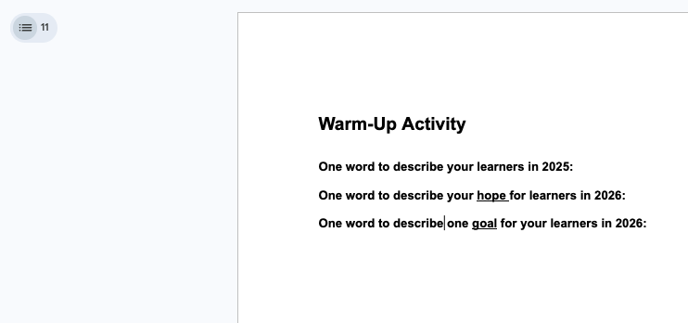
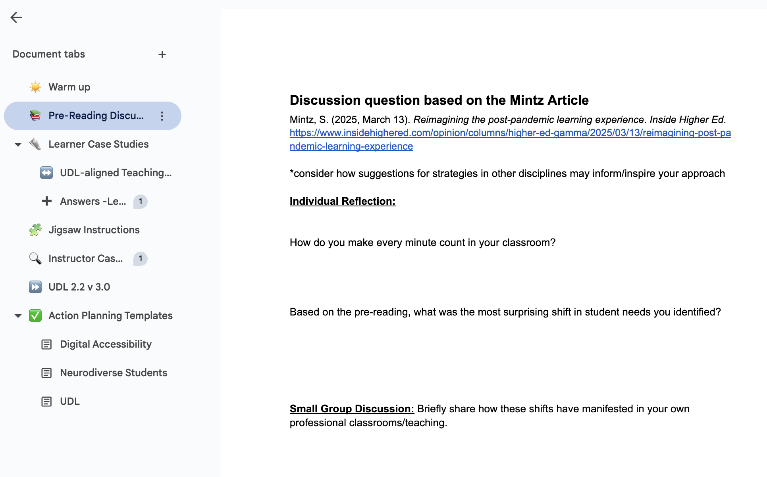
Navigate via Document Tabs

Slide 7

Warm-Up
One word to describe your learners in 2025?
One word to describe your hope learners in 2026?
One word to describe your goal learners in 2026?

Slide 8
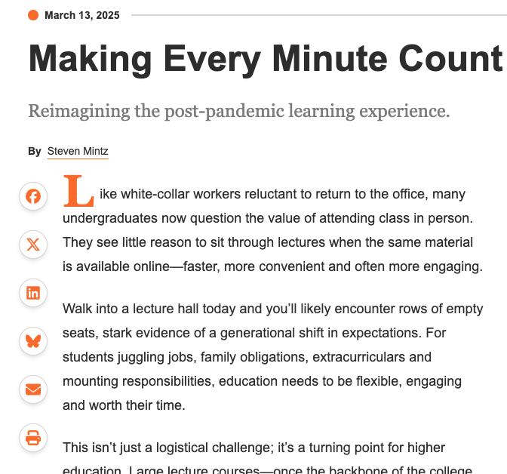
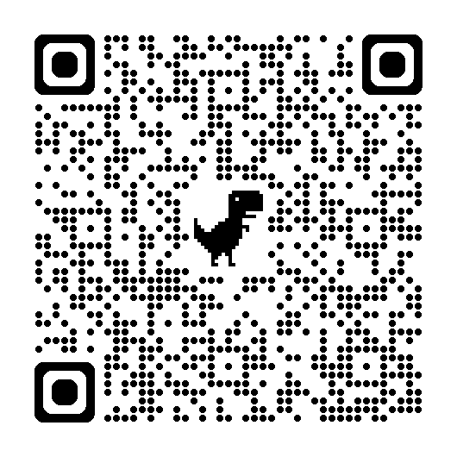
Pre-Reading Recap
Article: Making Every Minute Count
Prompts:
How do you make every minute count in your classroom?
Based on the pre-reading, what was the most surprising shift in student needs you identified?
Small Group Discussion:
Briefly share how these shifts have manifested in your own classrooms/teaching.

Slide 9

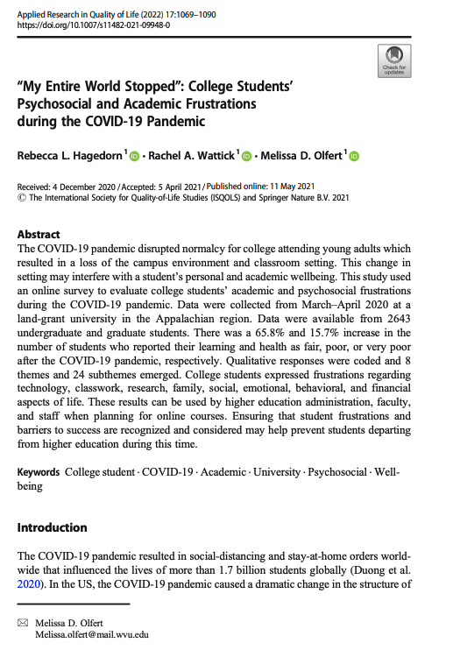
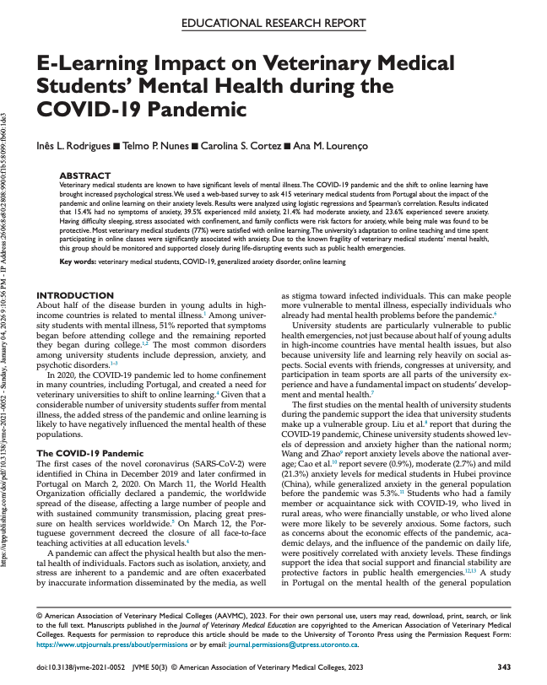
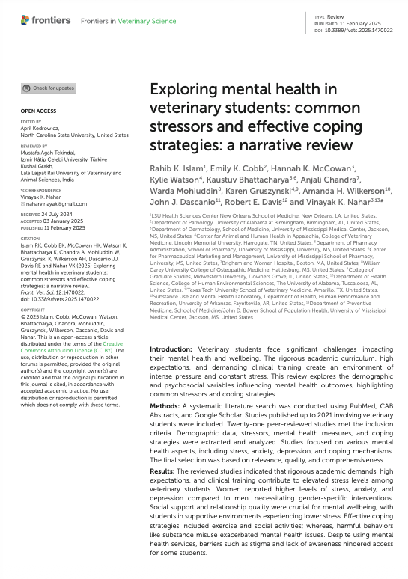
Post-pandemic Learning Landscape
Sources: Hagedorn, R. L., Wattick, R. A., & Olfert, M. D. (2021). “My entire world stopped”: College students’ psychosocial and academic frustrations during the COVID-19 pandemic. Applied research in quality of life, 17(2), 1069; Islam, R. K., Cobb, E. K., McCowan, H. K., Watson, K., Bhattacharya, K., Chandra, A., ... & Nahar, V. K. (2025). Exploring mental health in veterinary students: common stressors and effective coping strategies: a narrative review. Frontiers in veterinary science, 12, 1470022; Rodrigues, I. L., Nunes, T. P., Cortez, C. S., & Lourenço, A. M. (2022). E-Learning impact on veterinary medical students’ mental health during the covid-19 pandemic. Journal of Veterinary Medical Education, 50(3), 343-353. https://utppublishing.com/doi/pdf/10.3138/jvme-2021-0052

Slide 10
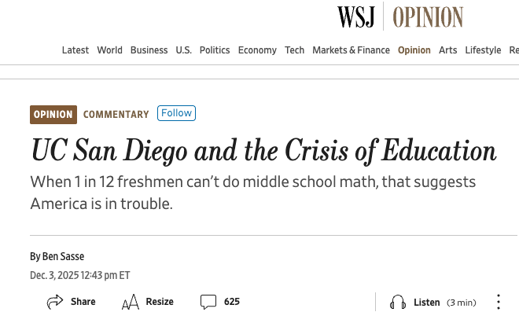
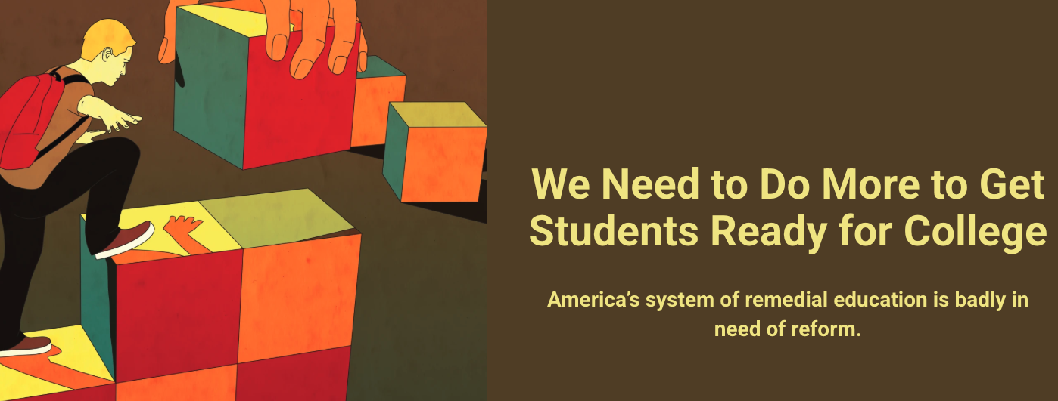
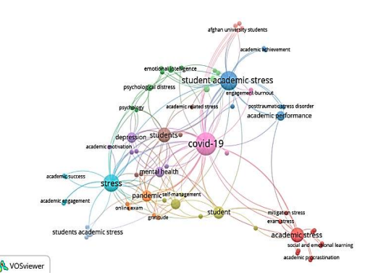
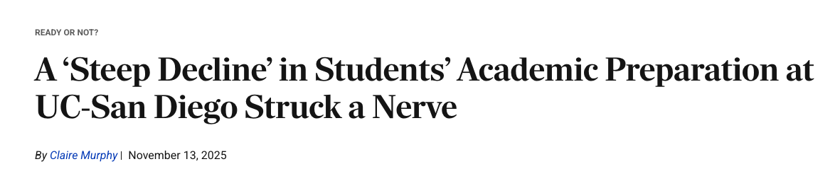
Post-pandemic Learning Landscape

Slide 11
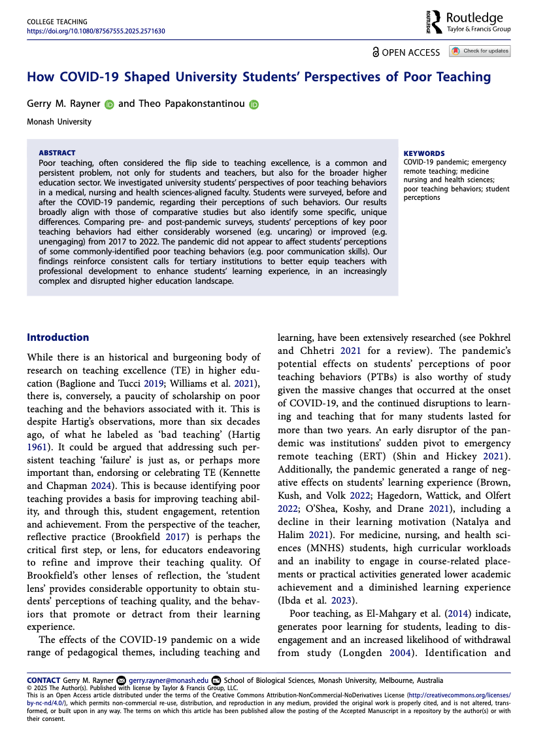
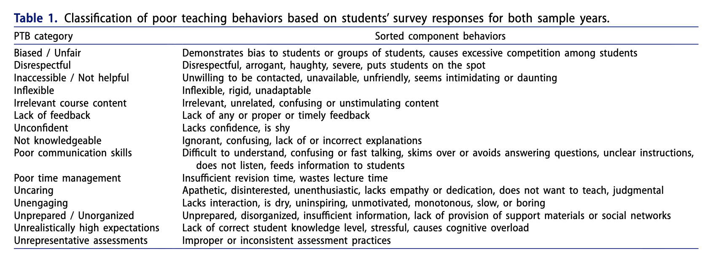
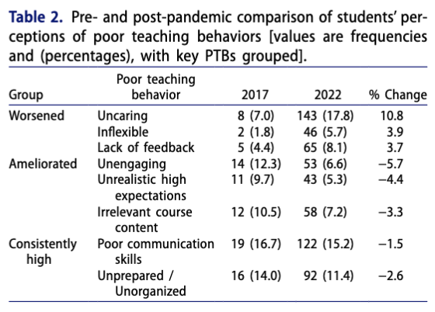
Post-pandemic Learning Landscape
Source: Rayner, G. M., & Papakonstantinou, T. (2025). How COVID-19 Shaped University Students’ Perspectives of Poor Teaching. College Teaching, 1-8.

Slide 12
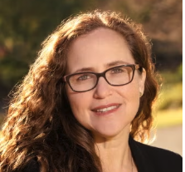
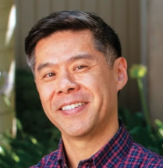
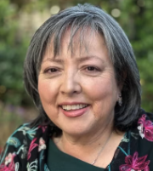
Post-pandemic Learning Landscape
Michal Kurlander: As of last spring [2024], students were still roughly half a year behind where their predecessors were in 2019…An important part of this story is that the impacts of COVID-19 have been extremely uneven—learning loss has been exacerbated by class, racial, and ethnic inequalities.
Kevin Gee: “...chronically absent students who were missing large amounts of school, and 81% of those kids said they want to come because of the people and their relationships.
We need to change the narrative back to what a huge difference a good teacher can make in the classroom.
Source: Education Experts Break Down the Lingering Impacts and Unexpected Outcomes of COVID-19 Pandemic

Slide 13
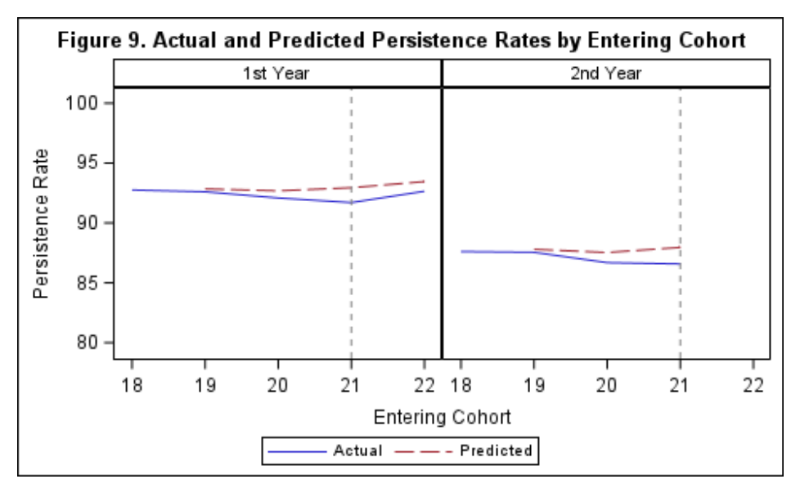
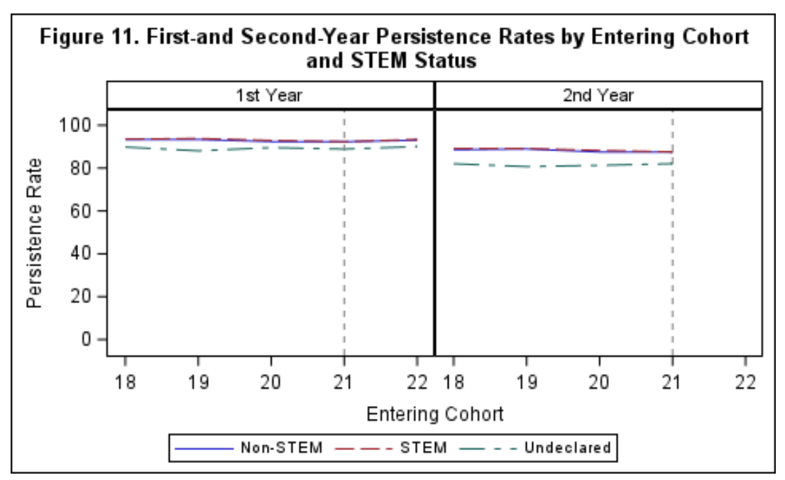
Post-pandemic Learning Landscape
Persistence rates for entering students in the UC System 2018-2022
Source: University of California, Office of the President, Institutional Research and Academic Planning. (2025, July). Admission outcomes and first- and second-year performance of freshman cohorts after the elimination of standardized test requirements for admissions at the University of California (Report). https://www.ucop.edu/institutional-research-academic-planning/_files/admissions-outcomes-and-performance.pdf

Slide 14
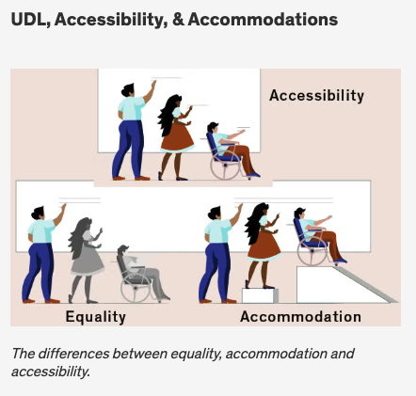
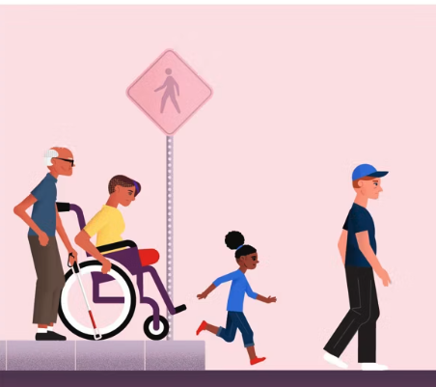
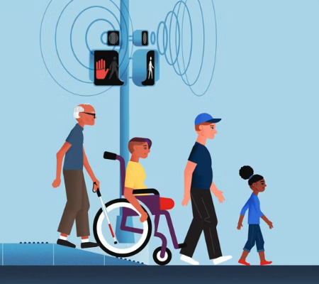
Accessibility, UDL, and Supporting All Students
Sources: RWJF Equity Graphics, Equity-Minded Teaching Pracitces Graphic Image

Slide 15
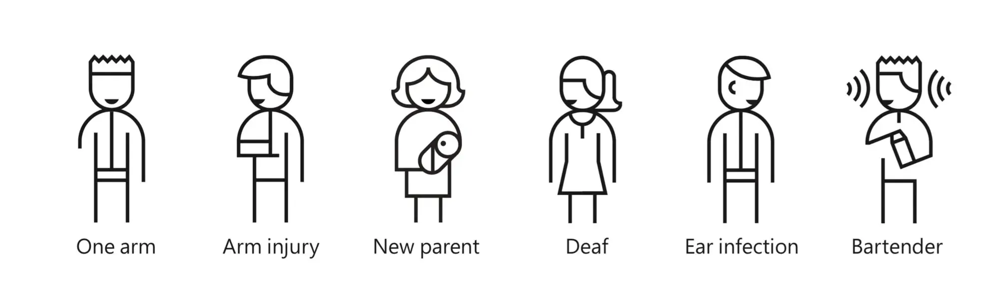
Digital Accessibility: Consider Situational Factors
Digital Accessibility (DA): Digital accessibility is the practice of creating digital content so that all people can access and use the materials, including individuals with disabilities who utilize assistive technology.
Images source: https://cstate.se/writing/wcag

Slide 16
Digital Accessibility = Student Success
“Faculty who communicate clearly, show respect, and respond to student needs, they help foster persistence and academic success.”
“Instructors implementing an advocacy-oriented mindset and view themselves as partners in the learning process, student outcomes improve. This is especially true when they offer flexibility and create a sense of belonging.”
Disabled students who experience individualized, empathetic interactions with instructors are more likely to feel supported, persist through academic challenges, and complete their degrees.”
Sources: Becker & Palladino, 2016; Dowrick et al., 2005; National Disability Center for Student Success, 2025; Woolf & De Bie, 2022 as cited in UDL Success Stories)

Slide 17
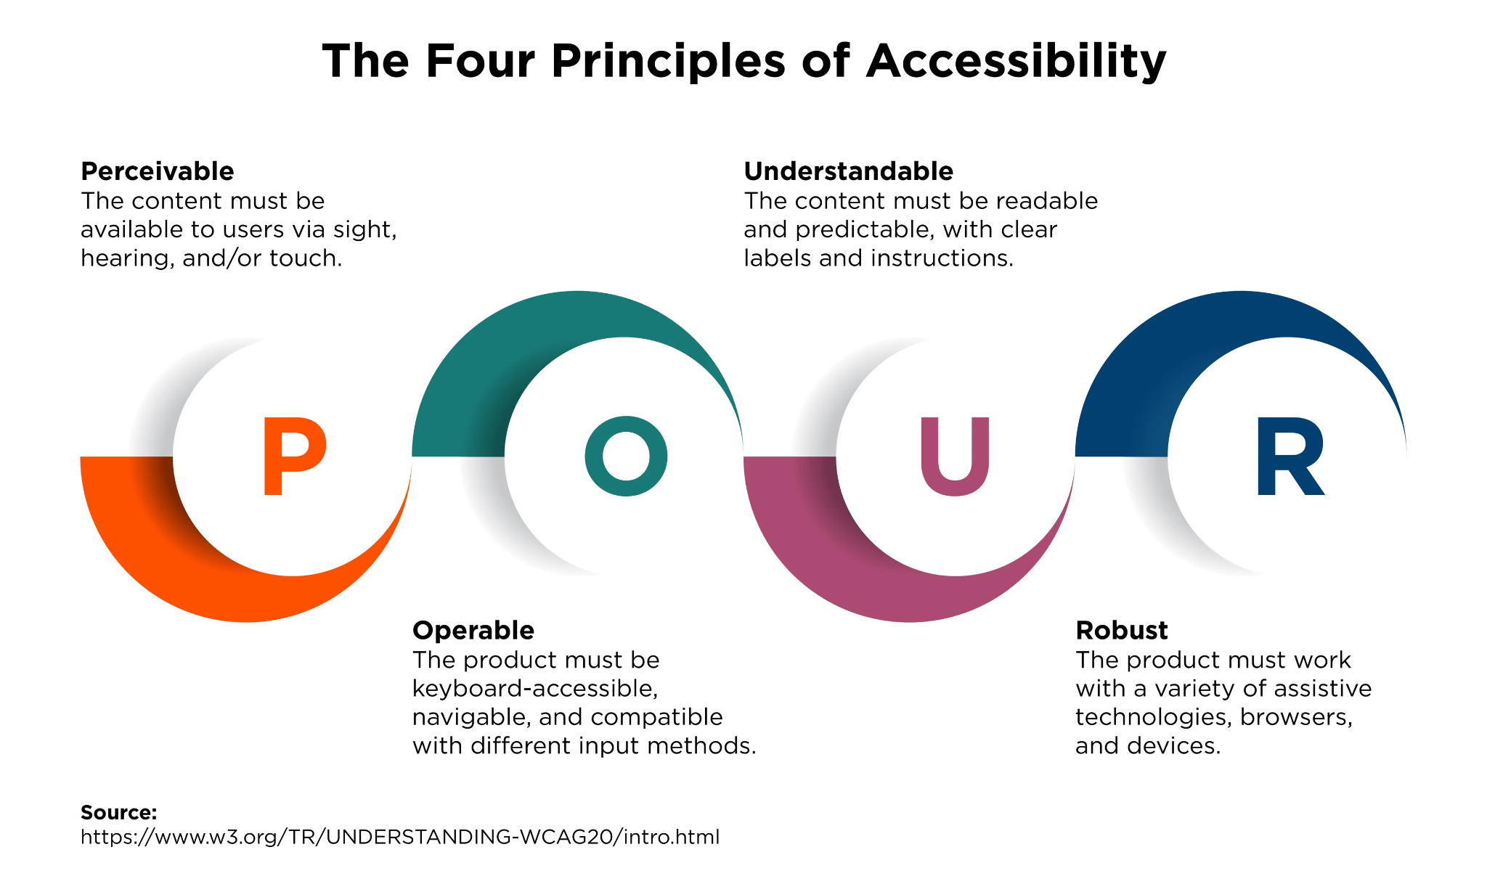

Slide 18
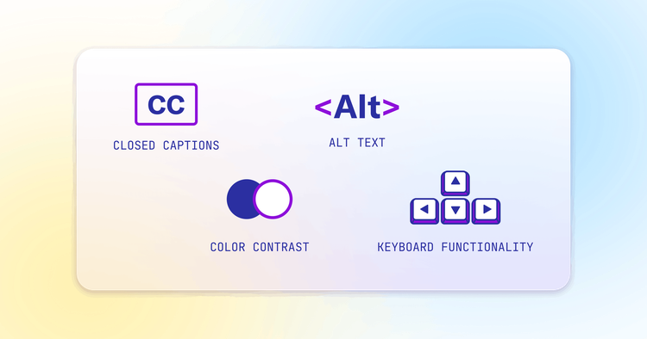
POUR Examples

Slide 19
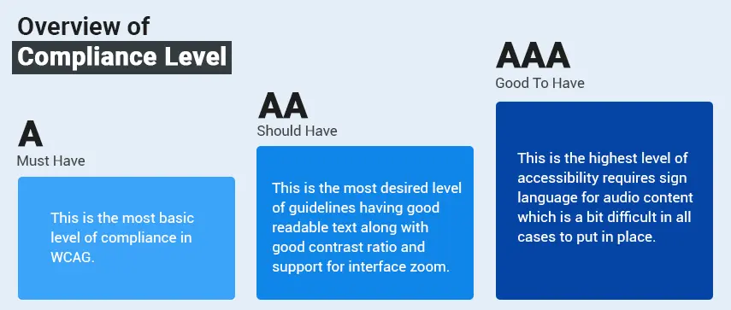
Web Content Accessibility Guidelines (WCAG)
2.1 Compliance
Image source: https://cstate.se/writing/wcag

Slide 20
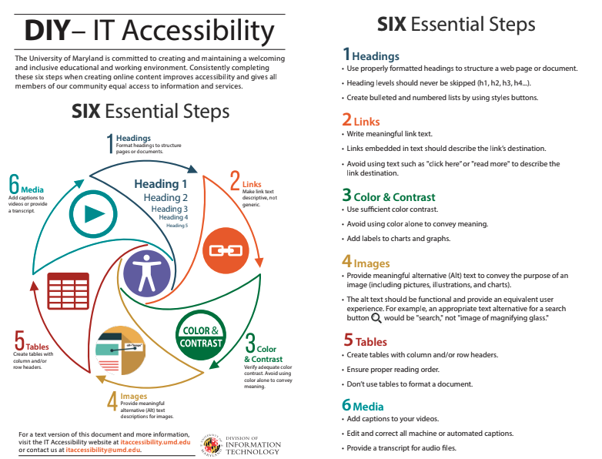
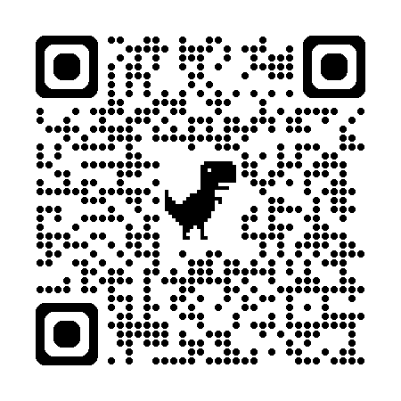
Digital Accessibility Essentials
Source: https://it.umd.edu/accessibility/six-essential-steps
Source: https://it.umd.edu/accessibility/six-essential-steps

Slide 21
Universal Design for Learning
“The goal of UDL is to support learner agency, the capacity to actively participate in making choices in service of learning goals. UDL aims to change the design of the environment rather than to situate the problem as a perceived deficit within the learner.”
The UDL Guidelines inform the design of learning environments to support learner agency that is:
Purposeful - internalized self-efficacy, acting in ways that are personally and socially meaningful.
Reflective - self-awareness and metacognition to identify internal motivations and external influences that support learning and make adjustments when necessary.
Resourceful - understanding and applying assets, strengths, resources, and linguistic and cultural capital.
Authentic - increasing comprehension and deepening understanding in ways that are genuine.
Strategic - setting goals and monitoring learning with intentionality and planfulness.
Action-oriented - self-directed and collective action in pursuit of learning goals.
Source: CAST Universal Design for Learning Guidelines

Slide 22
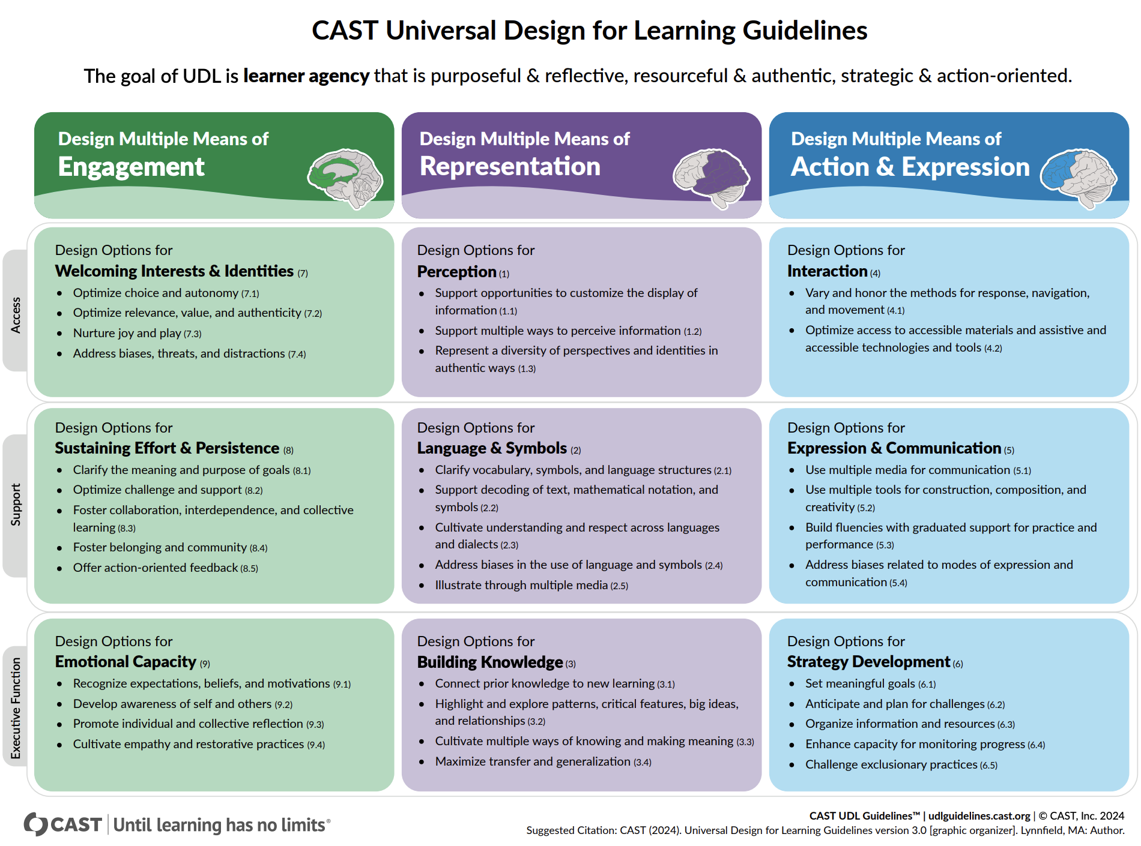
Universal Design for Learning
Source: CAST Universal Design for Learning Guidelines

Slide 23
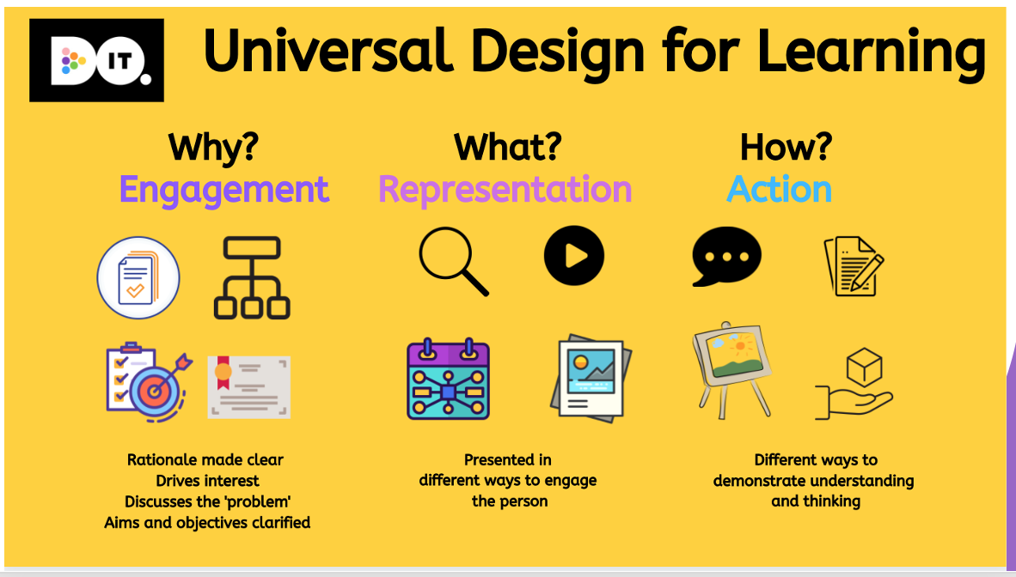
Universal Design for Learning -
Icon-based Summary
Source: CAST Universal Design for Learning Guidelines

Slide 24
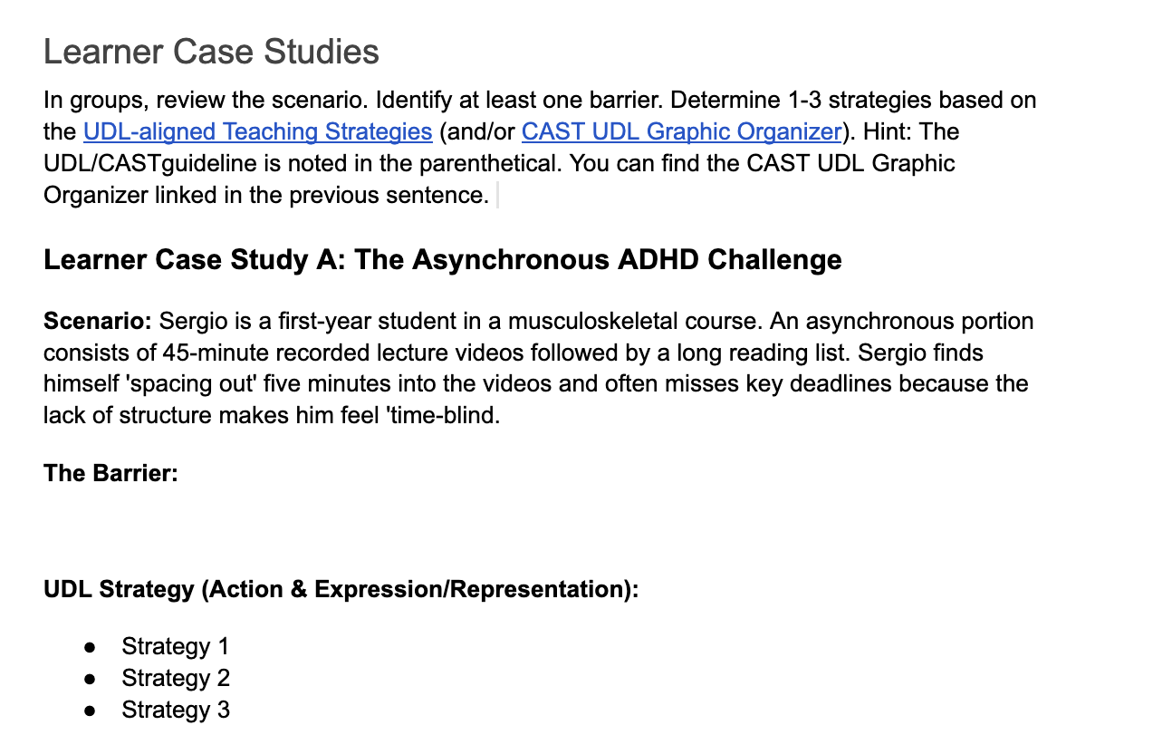

Learner Case Studies

Slide 25

Learner Case Studies (1 of 2)
Learner Case Study A (A&E/Representation)
Microlearning: Break the 45-minute video into segments with clear headings.
Interactive Checks: Embed interactive polls or "knowledge checks" every few minutes to refocus attention and self-assess.
Guided Notes: Provide a skeletal outline or "fill-in-the-blank" worksheet to keep Sergio’s hands and mind active during the lecture.
Learner Case Study B (A&E)
Alternative Demonstration: Allow Elena to perform an "assessment yarning" or oral examination (viva) where she narrates the process to a lab assistant who performs the actions.
Virtual Simulation: Provide a virtual lab alternative where she can demonstrate the steps using eye-tracking software or a simplified interface.
Extended Time: Grant rest breaks to manage the fatigue associated with navigating the physical environment with an injury.

Slide 26
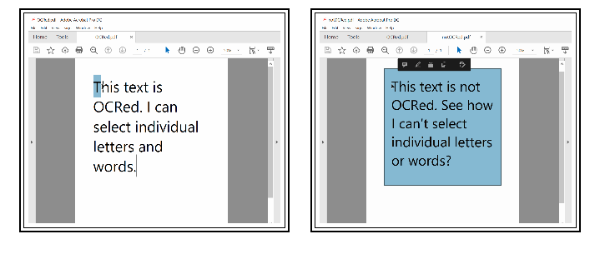
Learner Case Studies (2 of 2)
Learner Case Study (Representation)
Semantic Structure: Ensure all documents use proper headings and alt-text so screen readers can navigate logically.
Accessible Formats: Provide "Optical Character Recognition" (OCR) versions of all PDFs or convert them to accessible Word docs. Example of OCR in action (below)
Data Narration: Supplement every chart with a text-based summary of the "key takeaway" (e.g., "The chart shows a 20% increase in student engagement after UDL implementation").
Source: https://www.accessiblehighered.com/files-documents

Slide 27
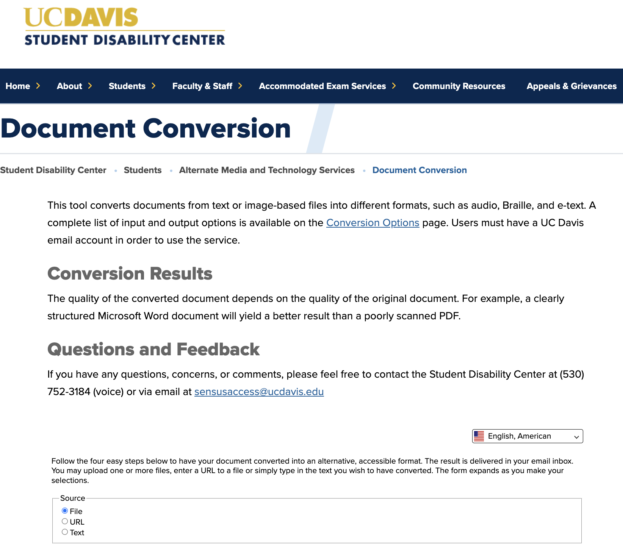
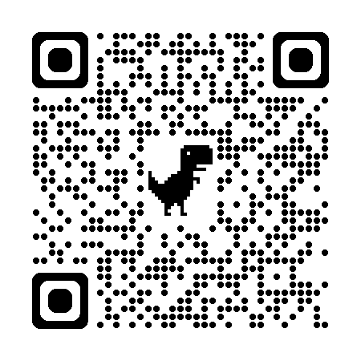
Learner Case Studies (2 of 2)
Learner Case Study (Representation)
UC Davis Document Conversion Site
https://sdc.ucdavis.edu/document-conversion
Source: UC Davis Document Conversion

Slide 28
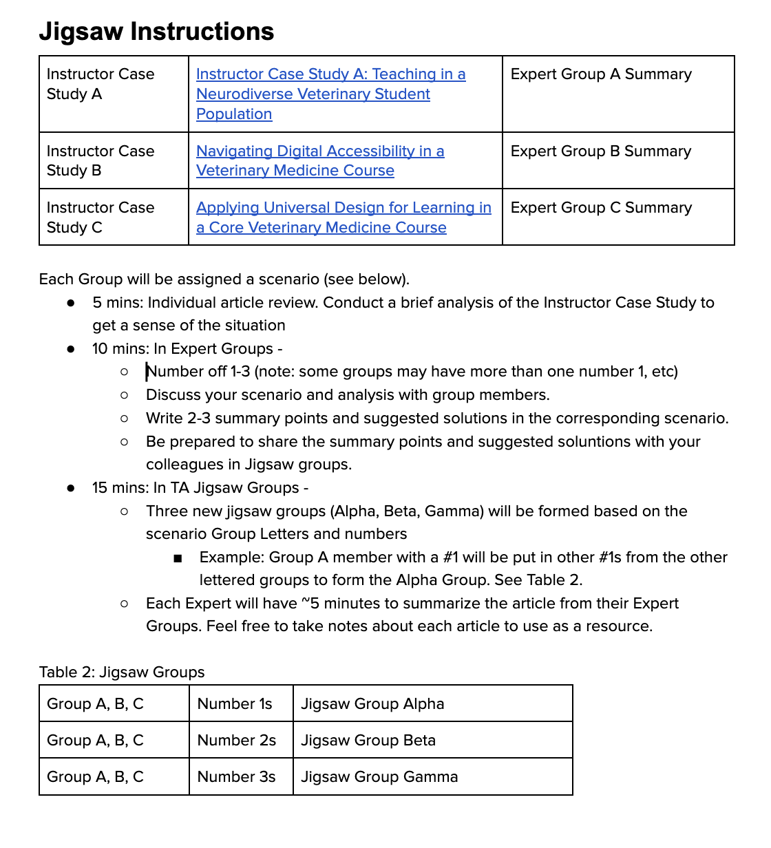

Jigsaw Case Studies

Slide 29
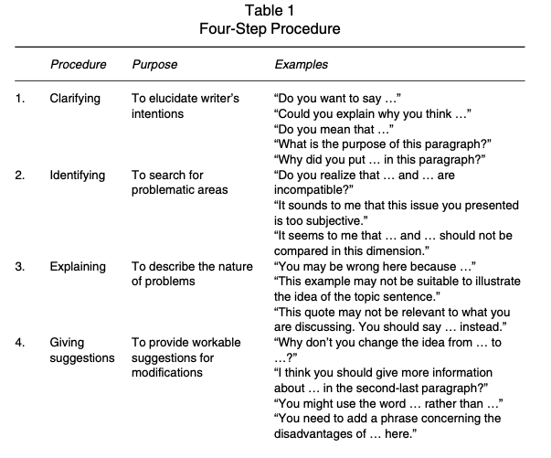
Instructor Case Studies (1 of 3)
Instructor Case Study A: Teaching in a Neurodiverse Veterinary Student Population
Scaffold assignments
Scaffold reading
Redefine “paying attention”
Redesign “discussion
Source: Lam, R. (2010). A peer review training workshop: Coaching students to give and evaluate peer feedback. TESL Canada Journal, 114-114.

Slide 30
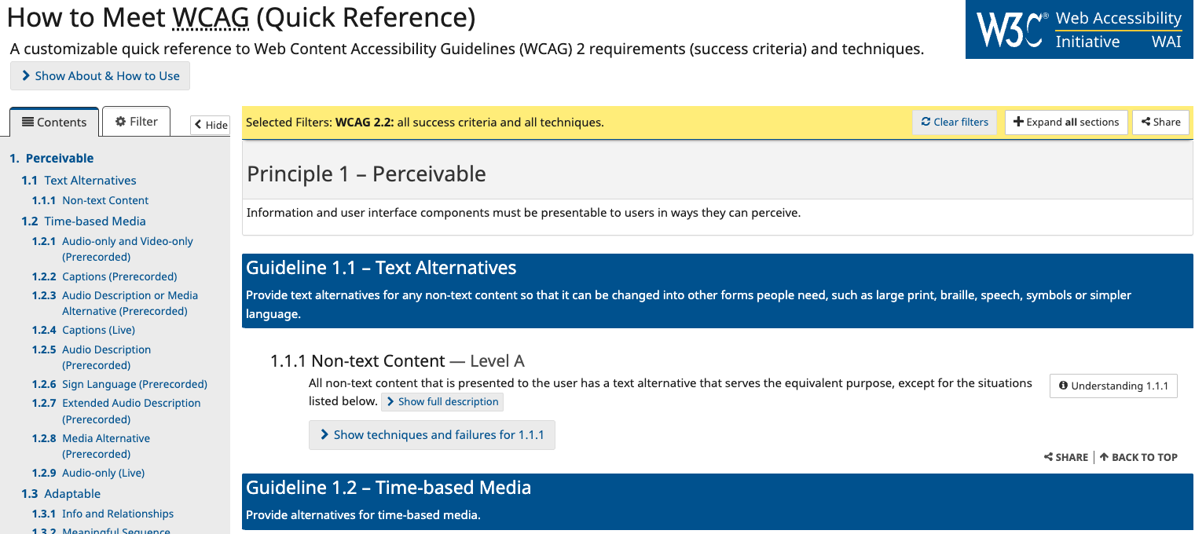
Instructor Case Studies (2 of 3)
Instructor Case Study B: Navigating Digital Accessibility in a Veterinary Medicine Course

Slide 31
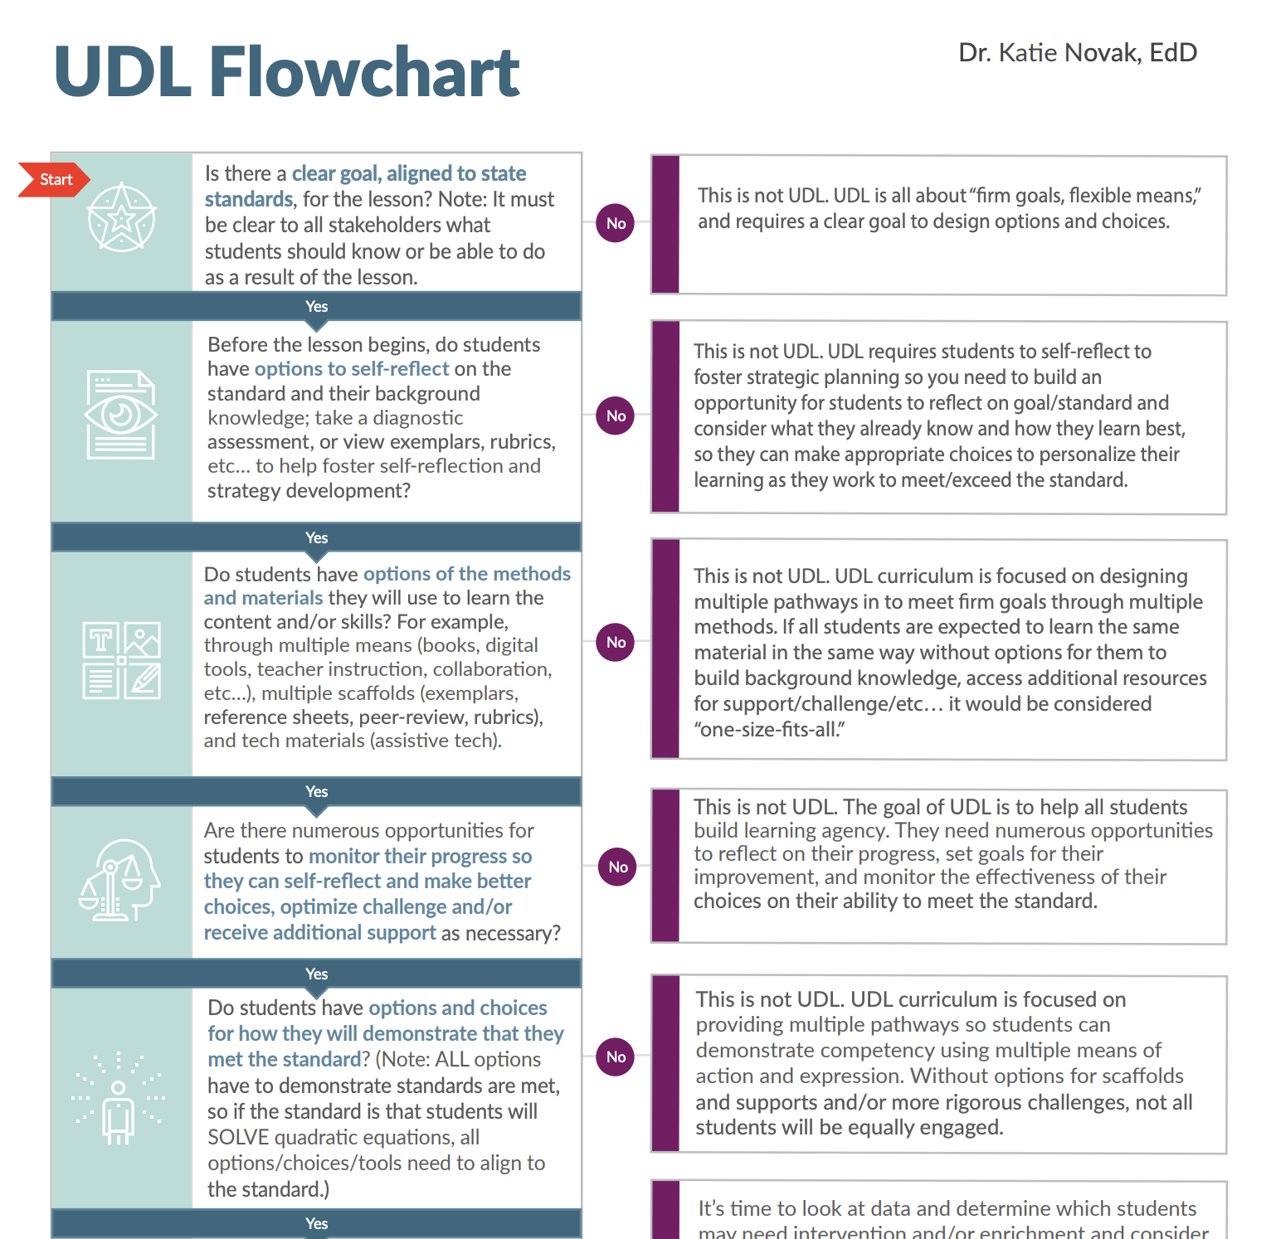
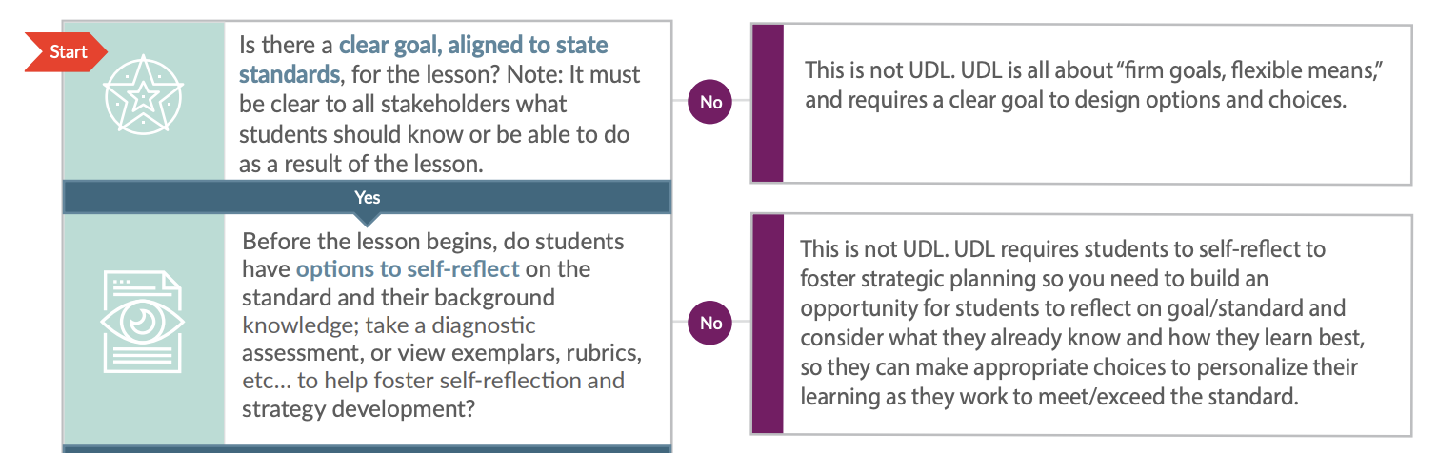
Instructor Case Studies (3 of 3)
Instructor Case Study C: Applying Universal Design for Learning in a Core Veterinary Medicine Course
Source: Novak, K (nd) UDL Flowchart

Slide 32
5 Practices for the
post-pandemic learner that integrate
Digital Accessibility and
Universal Design for Learning

Slide 33
1. Strategically address WCAG 2.1 compliance
Gradual Updates
Starting with your current term’s material, update one course per term You can focus on high-impact elements first, such as syllabi, course texts, and slide decks. This approach allows you to work incrementally through your courses.
Leverage Existing Accommodations
Start with materials that were previously created or adapted for students seeking accommodations. Upgrade these to meet all accessibility standards, then integrate them into your main course content. This approach turns one-off accommodations into inclusive content that benefits everyone.
Content Type Focus
Tackle one type of content at a time across all your courses. For example, this term you might focus on Word documents and PPT in all of your courses. Then next term, you might move onto images or spreadsheets. This approach helps you develop expertise in specific accessibility techniques.
Collaborative Approach
Partner with colleagues to share the workload. Divide materials by topic or type, then review and update each other’s work to share what you learned. This approach helps you build/further connections to colleagues and distribute the effort.
Adapted from: https://it.uic.edu/accessibility/digital-accessibility-training-resources/instructor-resources/

Slide 34
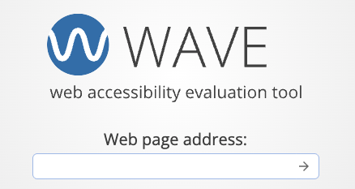

1. Strategically address WCAG 2.1 compliance:
Gradual Updates
Source https://wave.webaim.org/extension/

Slide 35
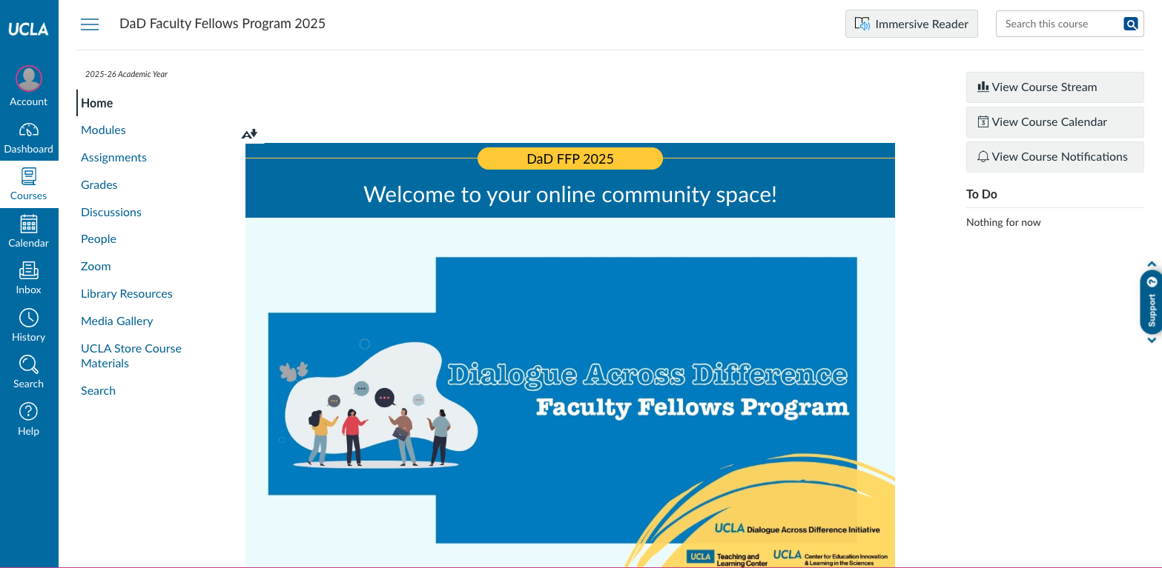
1. Strategically address WCAG 2.1 compliance:
Gradual Updates
Adapted from: https://bruinlearn.ucla.edu/courses/218797

Slide 36
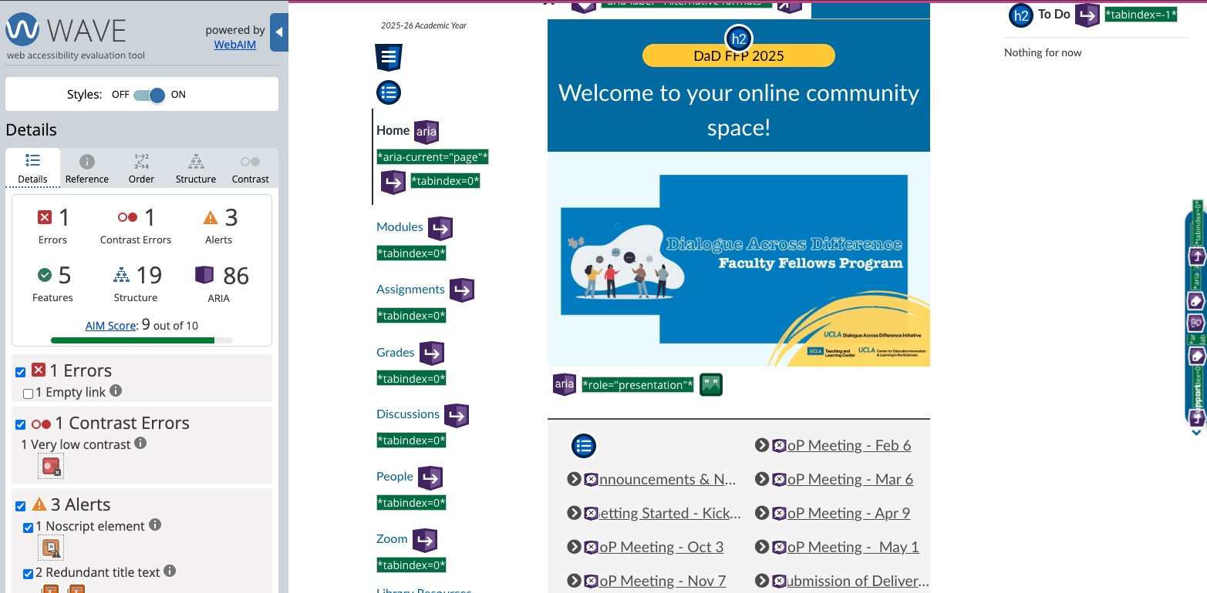
1. Strategically address WCAG 2.1 compliance:
Gradual Updates
Adapted from: https://bruinlearn.ucla.edu/courses/218797

Slide 37
1. Strategically address WCAG 2.1 compliance:
Content Type Focus
Screen readers can scan for links and create a list of links, so informative link text is helpful. Links in digital documents/pages should convey clear and accurate information about the destination.
Do NOT link pages with text such as “Click here”.
Good practice: UCLA Disabilities and Computing Program
Bad practice: https://dcp.ucla.edu/
Bad practice: Click here
Source: Making Your Course Accessible - Descriptive Links

Slide 38

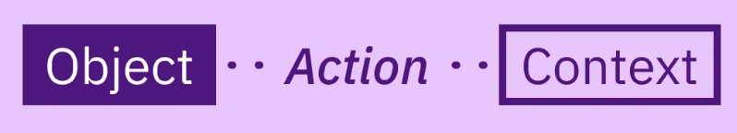
2. Object - Action - Context
Object | Action | Context
A dog | sitting | in fall leaves.
A light brown pitbull dog breed | sitting at attention | in a field of golden autumn leaves.
Source: Chen, A. (2020, July 17). How to write an image description. UX Collective. https://uxdesign.cc/how-to-write-an-image-description-2f30d3bf5546

Slide 39
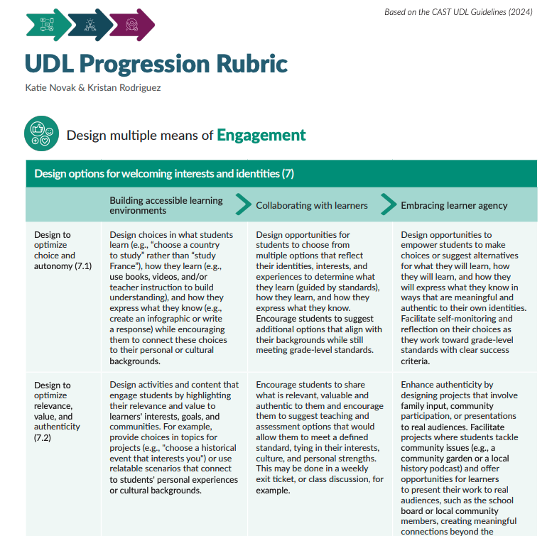
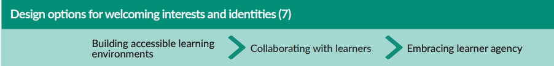

3. Progressively enhance materials

Slide 40

4. UDL +1 Approach
Selectively making changes that can scale to other teaching practices and materials
Source: Doyle, A. J., O’Toole, M., Cassidy, D., & Condron, C. M. (2025). Universal Design for Learning (UDL) in simulation-based health professions education. Advances in Simulation, 10(1), 33.

Slide 41

5. Consider Universal Design for Instruction
Universal Design for Instruction as framework to streamline adaptations for digital accessibility and UDL
Example: Deliver instructions clearly and in multiple ways. Make instructions clear in the syllabus and follow up with a question and answer session. Ask students to summarize instructions to ensure understanding. [UD 3, 4; UDL 1; WCAG]
Source: Burgstahler, S. (2020). Equal access: Universal design of instruction. DO-IT, University of Washington. https://doit.uw.edu/brief/equal-access-universal-design-of-instruction/

Slide 42
5. Consider Universal Design for Instruction
Align all assessments with learning outcomes so students can understand why they are being asked to do something.
Break down big assessments: Break large assessments or projects down into smaller assignments throughout the semester and provide formative feedback for each part to allow students to monitor their progress. Clearly provide interim dates for large assessments and prompt learners about upcoming deadlines.
Vary how students can respond: Add more options to assessments that have a single response mode (such as using only multiple choice, asking for only a written response, or asking learners to draw diagrams for every answer).
Deadlines Flexibility Provide alternative submission options and be flexible with submission dates.
Be explicit with assessment instructions. Ask someone else to review them to make them make sense. Consider adding a screencast of a process if students have difficulties with that process. Add an audio or captioned video version of your instructions to help students to understand what they need to do. Create a discussion forum for specific questions on assessments and add these questions to the instructions next time you run the assessment.
Share examples. Give examples of past students work and how they met the learning outcomes.
Source: UDL: Practical Ideas to Get Started

Slide 43
5. Embedded Scaffolding
Object | Action | Context
A dog | sitting | in fall leaves
A light brown pitbull dog breed | sitting | in a field of golden, autumn leaves
Source: https://uxdesign.cc/how-to-write-an-image-description-2f30d3bf5546

Slide 44




Slide 45

Closing Quotation
“Moving forward after the pandemic will not simply be a matter of more hours of rote work and frantically making up for lost time that we can’t really get back.
It will be a group project.”
G. Gabrielle Starr
Sources: how-recover-pandemic-learning-loss-opinion

Slide 46
New learners, new challenges,
and new opportunities:
Accessibility and Universal Design in post-pandemic professional education
Thank You!
Kem Saichaie, PhD
Inaugural Executive Director
UCLA Teaching and Learning Center
ksaichaie@teaching.ucla.edu
January 14, 2026

